Slide 1


Amur Tiger Detection using Deep Learning
Shankho Ghosh
Ketan Muddalkar
Ajay Patel
Vishnu B Nair
Mr. Balmukund Mishra
Ms. Divya Acharya
Mr. Tejalal Choudhary

Slide 2
Introduction
Detecting Amur tigers by object detection using deep learning techniques is our challenge .
The challenge was hosted by CVWC (Computer Vision for Wildlife Conservation)
ATRW(Amur Tiger Re-identification for Wild) was the dataset used.

Slide 3
Dataset Used
The dataset provided by CVWC was of 2.1GB.
Consisted 2700 images of tigers and their annotation files in .xml format.
Split Ratio:- 90:10.
Training Set :- 2400 images.
Testing Set :- 300 images.

Slide 4
Methodology / Model Used
Dependencies :- Tensorflow-gpu 1.5.0, Python 3, Matplotlib, OpenCV and CUDA and cuDNN.
Faster RCNN, SSD and SSD Lite were the models selected for this purpose.
The Pre-trained models were downloaded from github repository and their hyper parameters were tuned to suit our dataset.
With little amount of hyper-parameter tuning we were able to achieve the

Slide 5
Results Achieved
Faster RCNN model :- 94% accuracy with low loss values.
SSD inception v2 :- 90% accuracy with high classification loss.
SSD Lite MobileNet :- 95% accuracy with high loss values.

Slide 6
Results Achieved
Models
 | Faster R-CNN Inception v2 | SSD Inception v2 | SSD LITE Mobilenet
mAP@IoU0.5 | 0.9437 | 0.9095 | 0.9554
Steps | 2,00,000 | 1,00,000 | 1,30,000
Classification Loss | 0.123126 | 5.8326 | 3.052575
Localization Loss | 0.112125 | 0.662244 | 0.442702
Parameters

Slide 7
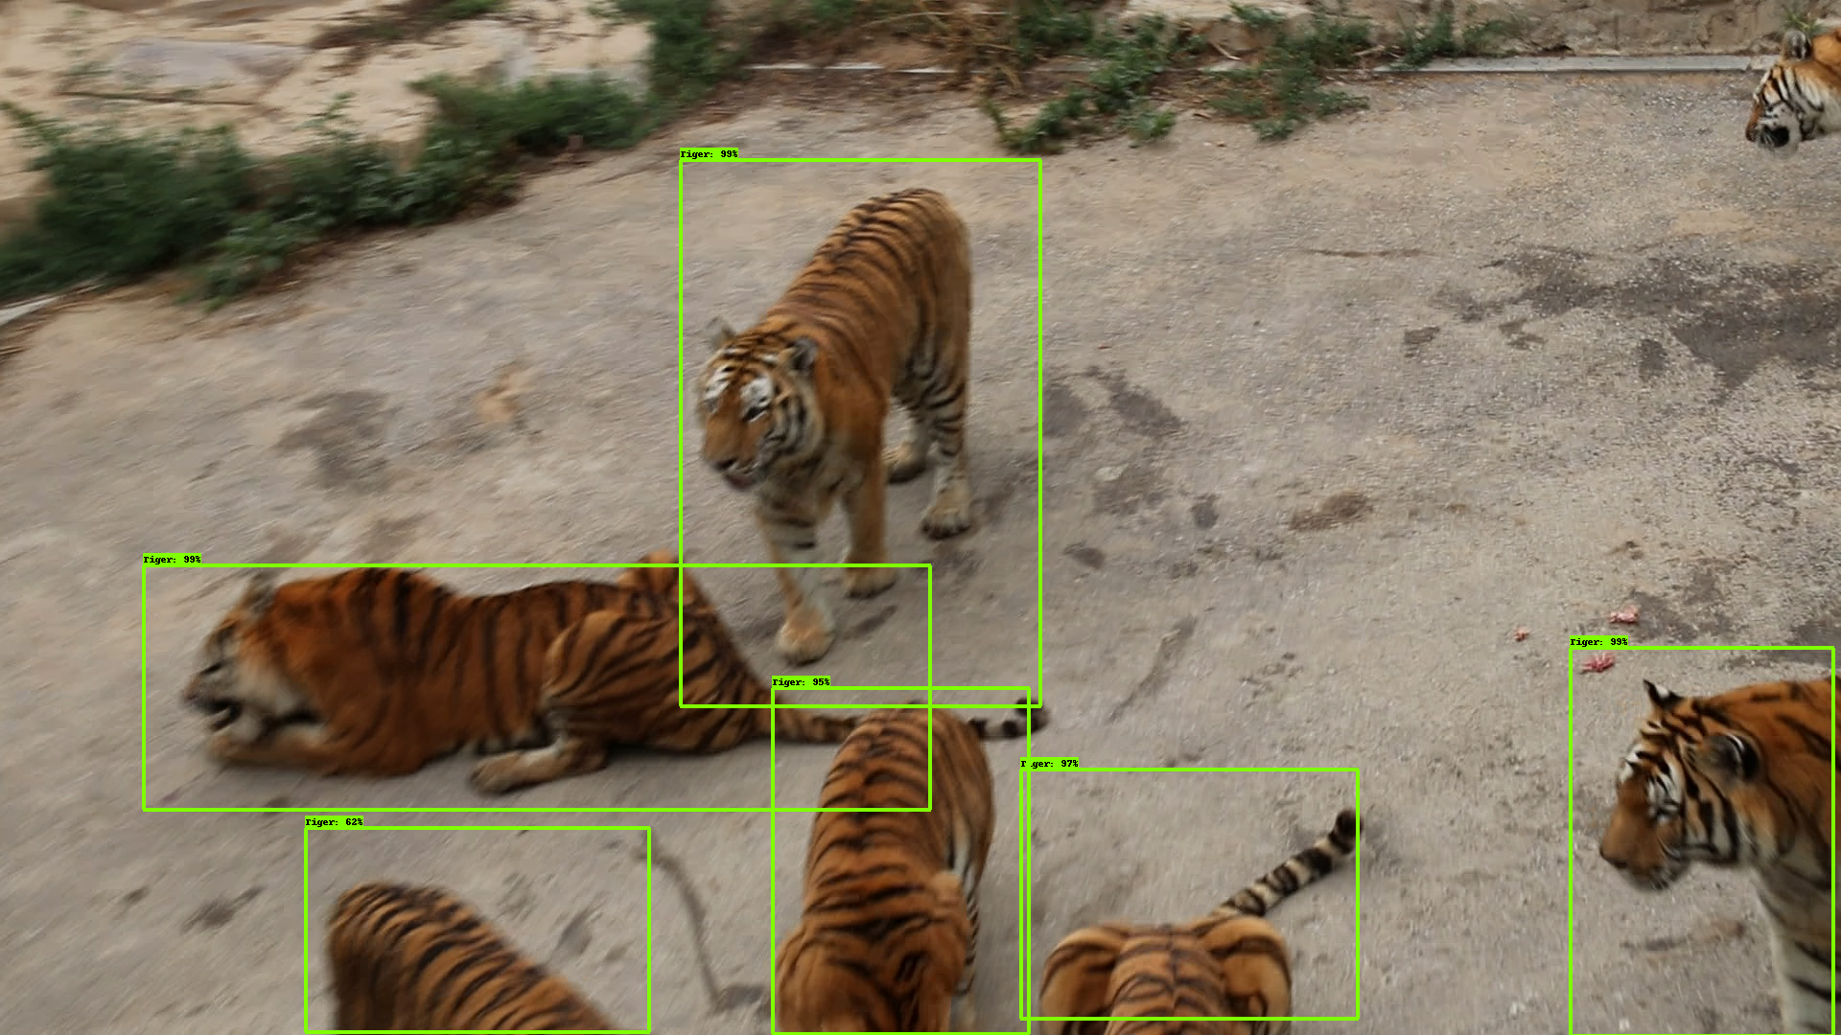
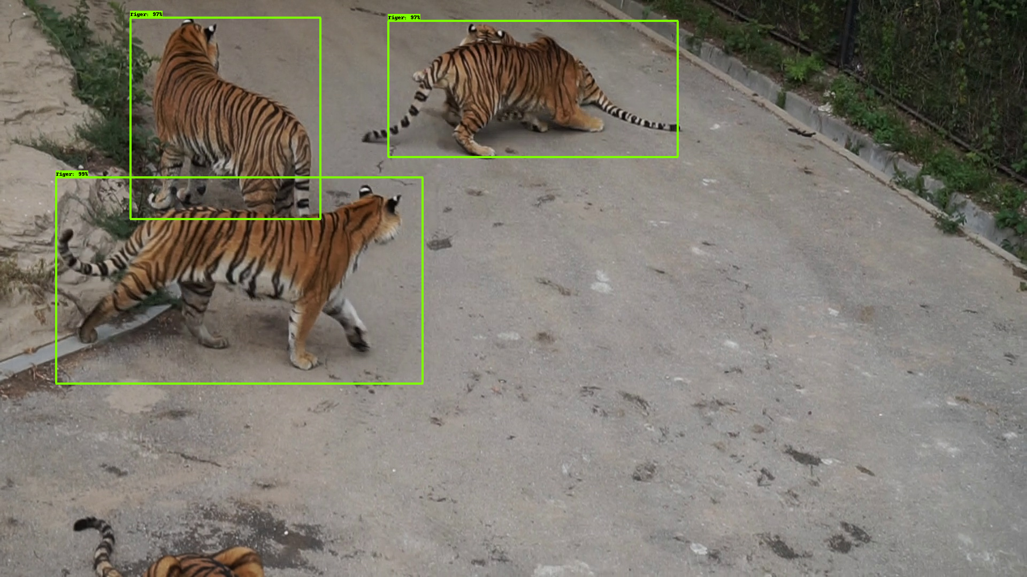
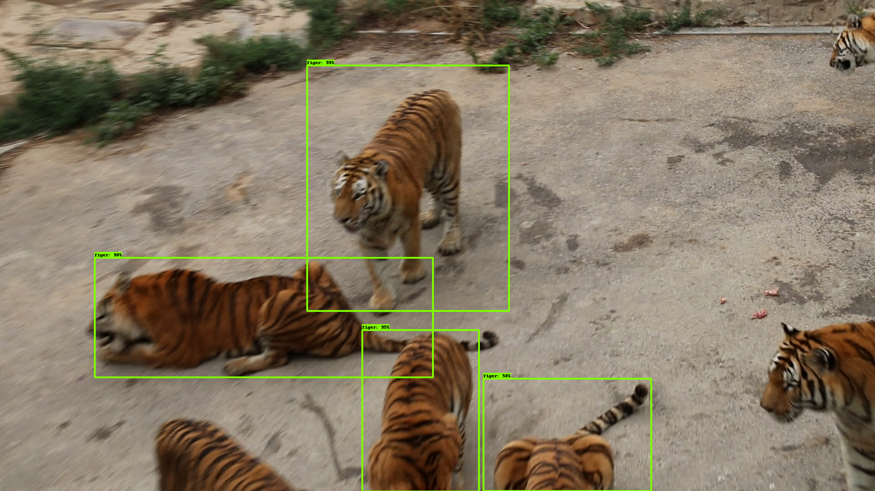
Results Achieved
Faster R-CNN
SSD Inception v2
SSDLite Mobilenet

Slide 8
Conclusion
We have presented a novel method to detect Amur tigers using deep learning techniques .
90% plus accuracy was achieved in all the three models that were trained.
This project can be further progressed by training on tiger pose detection and Re-ID datasets by CVWC and deploying it on mobile computers like Raspberry Pi and NVIDIA Jetson Nano extending upto drones.

Slide 9
References
https://cvwc2019.github.io/challenge.html
▪https://github.com/Edje-Electronic/tensorflow-object detection
▪https://arxiv.org/pdf/1906.05586.pdf
▪https://ieeexplore.ieee.org/document/8510564

Slide 10
Thank You

